Slide 1
Ysleta ISD Testing Pilot Overview

Slide 2
Dr. De La Torre
Superintendent of Schools

Slide 3
Overview of Testing
The Ysleta Independent School District is among a group of Texas school districts that will participate in a pilot program through Gov. Greg Abbott’s office to conduct mass COVID-19 rapid testing of its employees and students.
Through the pilot program, Ysleta ISD is expected to receive about 12,000 COVID-19 rapid tests called BinaxNOW COVID-19 Ag Card. It is an antigen test, which is designed to detect proteins from the virus that causes COVID-19. Positive results from these rapid tests are highly accurate and can help limit the spread of COVID-19 among families and communities.

Slide 4
Process

Slide 5
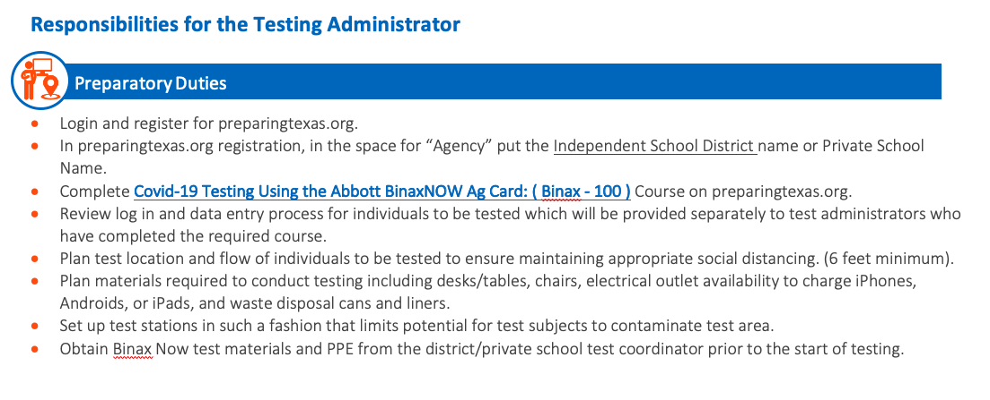

Slide 8
Timeline
This week we will accomplish the following as part of the pilot program:
Tuesday, October 13th -Test Central Office employees reporting
Wednesday, October 14th - Test Central Office employees, Test and train Principals/Aps, Test Transportation Mechanics and Maintenance Personnel at Yermoland
Thursday, October 15th - Test athletics teams, teachers, administrators, cafeteria workers, custodial staff, security at Del Valle High School

Slide 9
What we need from you
Complete the training and the test, so we can lead the way for our staff and students. The course and test take about 30 minutes and are designed for non-medical personnel.
Encourage your teachers to participate to test on Thursday, October 15, 2020.

Slide 10
Questions

