Slide 1
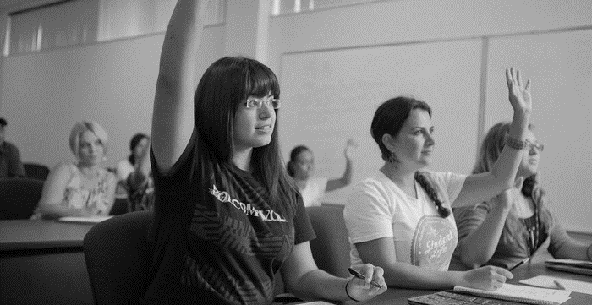
RGV FOCUS
Educating the Children of Poverty Roundtable Update
September 12, 2016 | State Board of Education

Slide 2
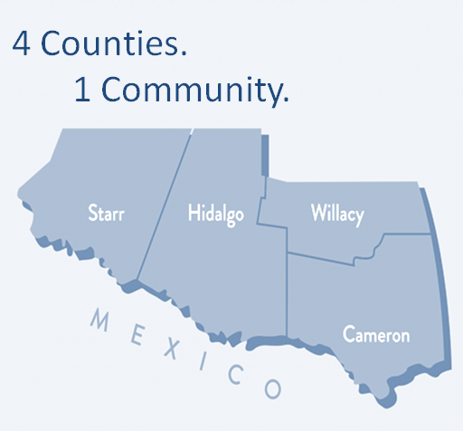
Young and Latino
Population
1.3 Million
90% Latino
Median Age
29 years (RGV)
34 years (Texas)
37 years (US)
Area
4,316 square miles
Source: U.S. Census Bureau, 2010-2014 American Community Survey
Notes:
43,00 square miles comes from the Texas State Historical Association https://tshaonline.org/handbook/online/articles/ryr01

Slide 3
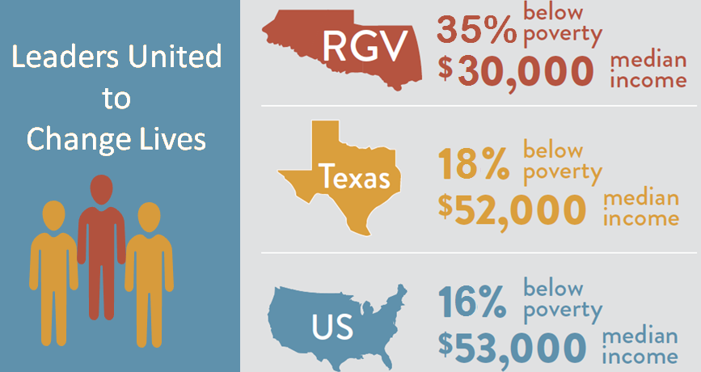
Double the National Poverty Rate
Source: U.S. Census Bureau, U.S. Census Bureau, 2010-2014 American Community Survey

Slide 4
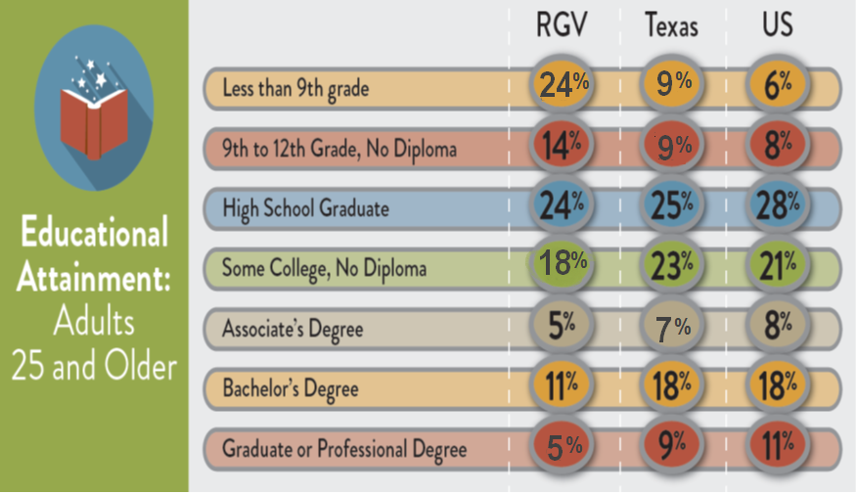
Large Educational Disparities
Source: U.S. Census Bureau, 2010-2014 American Community Survey

Slide 5
RGV ISDs 7th Grade Cohort Data
Entering 7th Graders
51,063
Graduate HS within 6 Years
38,985
Enroll in Postsecondary Immediately
21,899
100%
76%
43%

Slide 6
RGV ISDs 7th Grade Cohort Data
Enroll in Postsecondary Immediately
21,899 (43%)
2 Year Institution Enrollment
11,007 (22%)
Complete Credential in 6 Years
5,624 (11%)
10,892 (21%)
Credential Completion in 6 Years
3,834 (7.5%)
4 Year Institution Enrollment
18.5%

Slide 7
Educational Profile
K-12 System
39 School Districts
Awards
347,337 Students
20,383 HS Graduates
97.3% Latino
86.7% Economically Disadvantaged
33.5% English Language Learners
1 University*
Doctorates 20
Certificates/ Completers 2,432
Higher Education
2 Community Colleges
1 Technical College
68,993 Students
91% Latino
Baccalaureates 3,999
Associates 3,796
Masters 1,016
Source: TEA, TAPR Reports, 2013-2014
Source: THECB, Higher Ed. Accountability System (2015)
* Starting in fall 2015, The University of Texas Rio Grande Valley was created, brining together the resources and assets of The University of Texas at Brownsville and The University of Texas-Pan American.
Notes:
K-12 System (Red)
39 School Districts
347,686 Students
20,118 HS Graduates
97.6% Hispanic
88.4% Economically Disadvantaged
33.4% Limited English Proficiency
Higher Education (Green)
1 University
2 Community Colleges
1 Technical College
68,993 Students
91.1% Hispanic
Awards (Blue)
Doctorates 20
Masters 1016
Baccalaureates 3999
Associates 3796
Certificates/Completers 2432

Slide 8
What is Collective Impact?
Common Agenda
Common Progress Measures
Mutually Reinforcing Activities
Backbone Organizations
A lead organization that manages collaborations
Communications
A central point that connects collaborating organizations
Each partnership level of expertise is a contributing asset
Aligns the level of success across collaborating organizations
Aligns the mission and purpose of partnering organizations
1
Collective impact is a framework that focuses on bringing members from different sectors within a community together to drive large scale social change.
In order for the framework to be effective, the following conditions must be met.
2
3
4
5

Slide 9





















RGV FOCUS Leadership Team
K-12 |  | Higher Education | Community Based
Esperanza Zendejas Brownsville ISD | Daniel King PSJA ISD | Mike Shannon Texas Southmost College | Cornelio Gonzlez Region One ESC | Juanita Valdez-Cox La Union del Pueblo Entero
Arturo Cavazos Harlingen CISD | Alda Benavides La Joya ISD | Shirley Reed South Texas College | Wynn Rosser Greater Texas Foundation | Mike Seifert Equal Voice Network
Eduardo Infante Lyford CISD | Tom Torkelson IDEA Public Schools | Stella Garcia Texas State Technical College Harlingen | Frank Almaraz Workforce Solutions | Pat Hobbs Workforce Solutions Cameron County
Jose A. Gonzalez McAllen ISD | Gonzalo Salazar Los Fresnos CISD | Guy Bailey UT Rio Grande Valley | Traci Wickett United Way of Southern Cameron County
Marla Guerra South Texas ISD | Lisa Garcia Point Isabel ISD

Slide 10
Vision and Goals
All RGV learners will achieve a degree or credential that leads to a meaningful career
All RGV students graduate high school college ready
All high school graduates transition to postsecondary within a year
All postsecondary students can achieve a degree or credential on time
All postsecondary graduates can be employed within 6 months

Slide 11
Strategic Priorities
College & Career Readiness
Career Connections
College Supports
Teaching Excellence
Dropout Prevention & Recovery
Culture of Attending College
2013
2013
2015
2016

Slide 12
Trending Above State: 7 out of 9

Slide 13
Progress moves at the speed of trust.
~Angelo Gonzales,
Mission: Graduate (New Mexico)

Slide 14
Luzelma Canales, Executive Director
956-225-5535 | lcanales@cftexas.org
Eugenio Longoria Sáenz, Deputy Director
814-321-3515 | esaenz@cftexas.org
María Esther Rodríguez, Associate
956-802-2142 | erodriguez@cftexas.org
David Franco, Associate
214-750-4243 | dfranco@cftexas.org
Melba D. Garcia, Team Assistant
830-591-3380 | mgarcia@cftexas.org
Contact Information
http://rgvfocus.org

