Slide 1
12 September 2016
Achievement and Opportunity in America: What Can We Do?
Conference on Educating Students in Poverty
Austin, Texas

Slide 2
America: Two Powerful Stories

Slide 3
1. Land of Opportunity:
Work hard, and you can become anything you want to be.

Slide 4
2. Generational Advancement:
Through hard work, each generation of parents can assure a better life — and better education — for their children.

Slide 5
These stories animated hopes and dreams of people here at home
And drew countless immigrants to our shores

Slide 6
Yes, America was often intolerant…
And they knew the “Dream” was a work in progress.

Slide 7
We were:
The first to provide universal high school;
The first to build public universities;
The first to build community colleges;
The first to broaden access to college, through GI Bill, Pell Grants, …

Slide 8
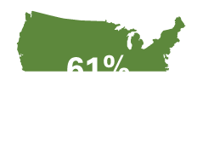
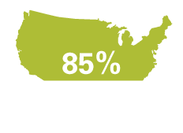
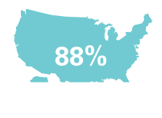
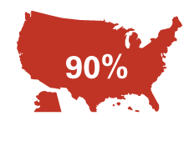
Percent of U.S. adults with a high school diploma
1920
1940
1960
1980
2000
2012

Slide 9
Percent of U.S. adults with a B.A. or more
1920
1940
1960
1980
2000
2012
11%
23%
29%
6%
4%
33%

Slide 10
Progress was painfully slow, especially for people of color. But year by year, decade by decade…

Slide 11
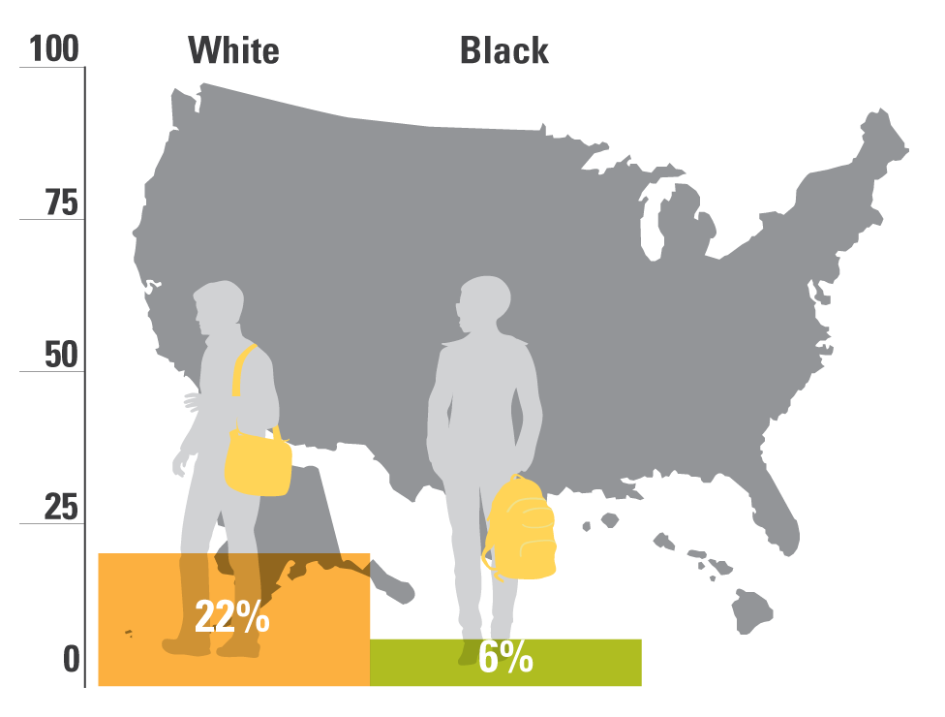
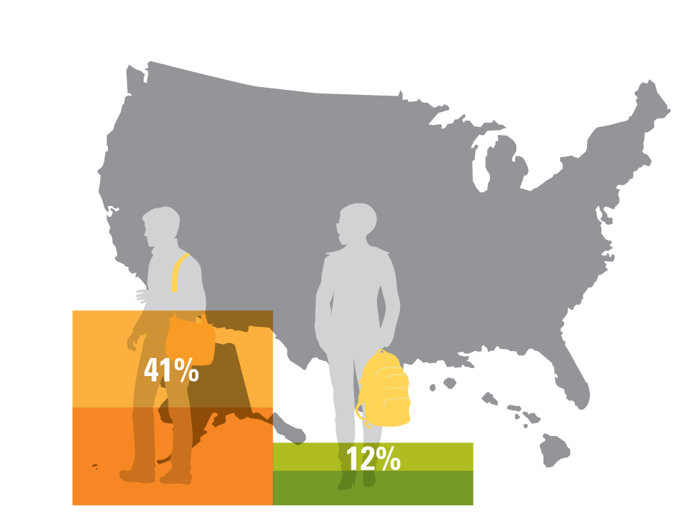
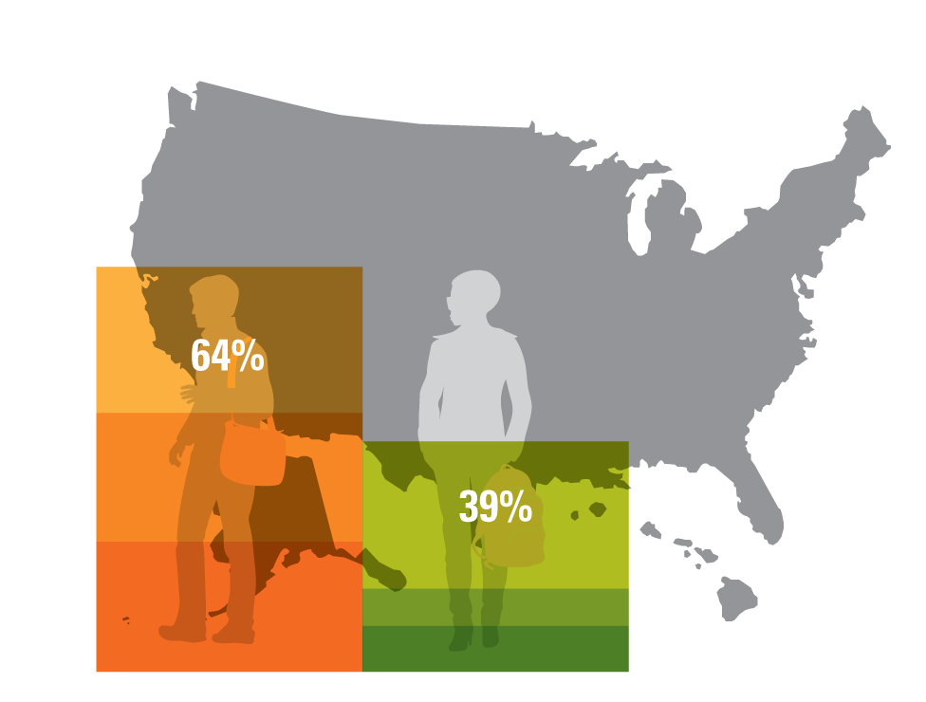
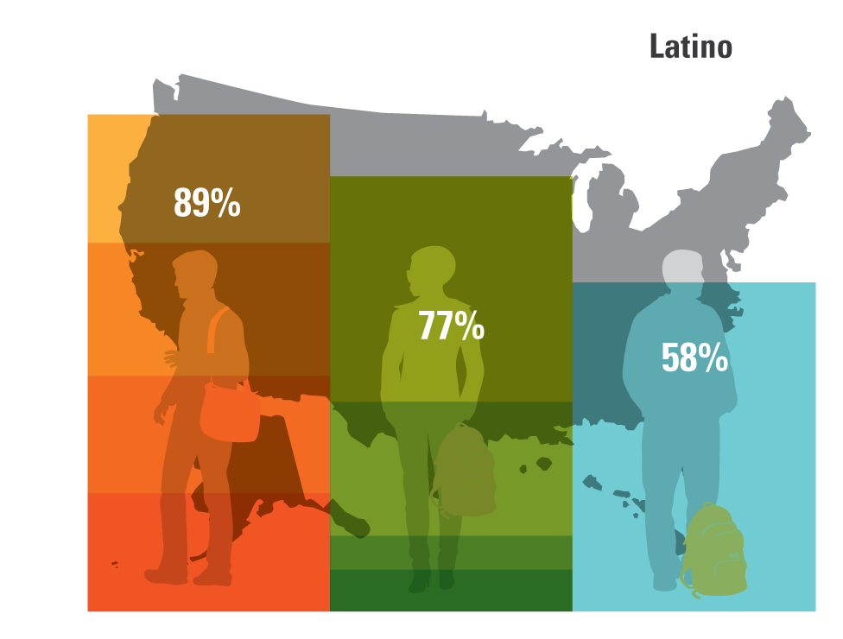
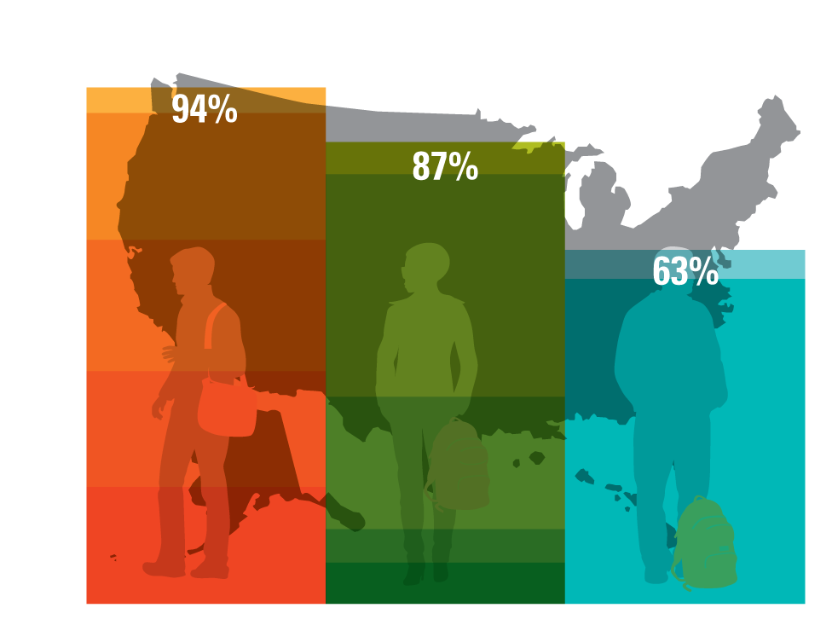
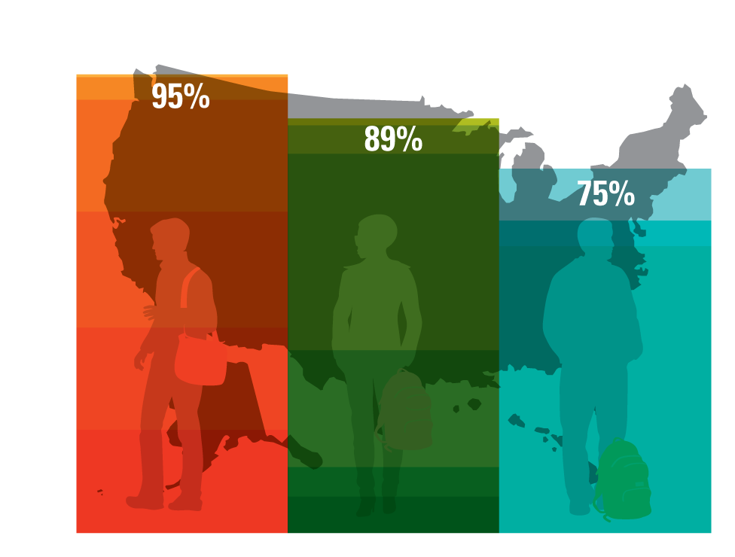
Percent of U.S. adults with a high school diploma, by race
1940
1920
1960
1980
2000
2012

Slide 12
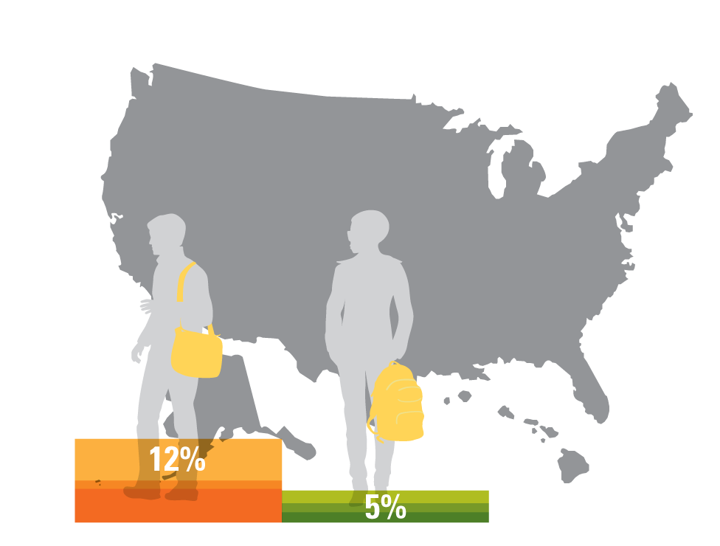
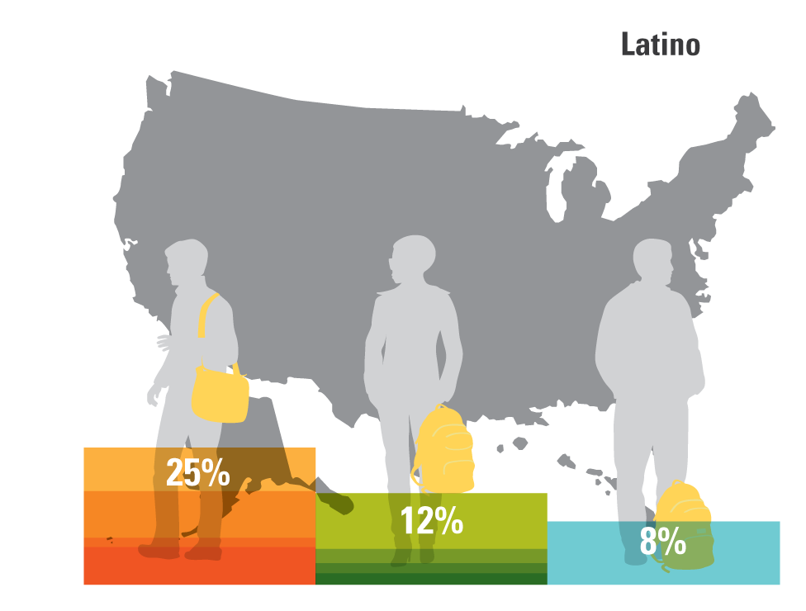
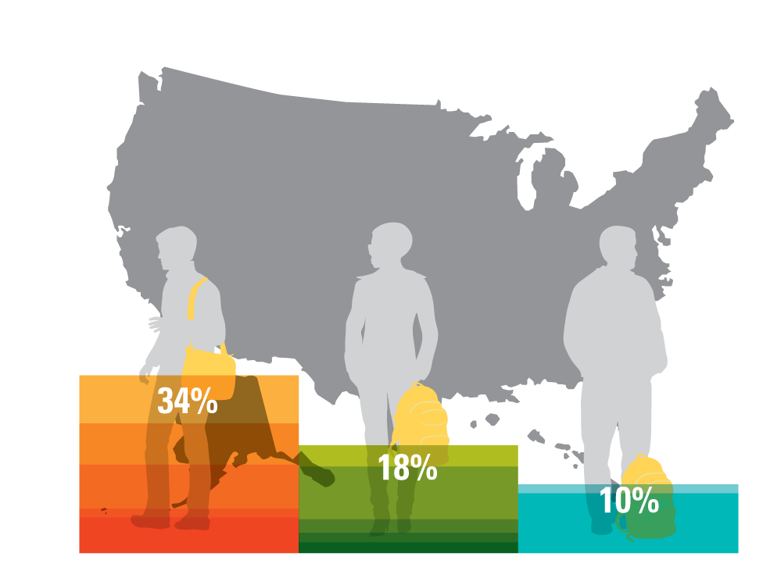
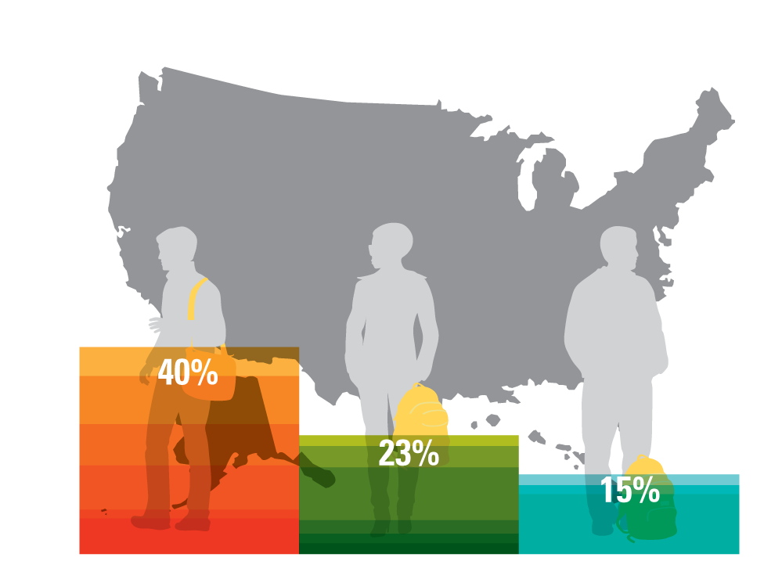
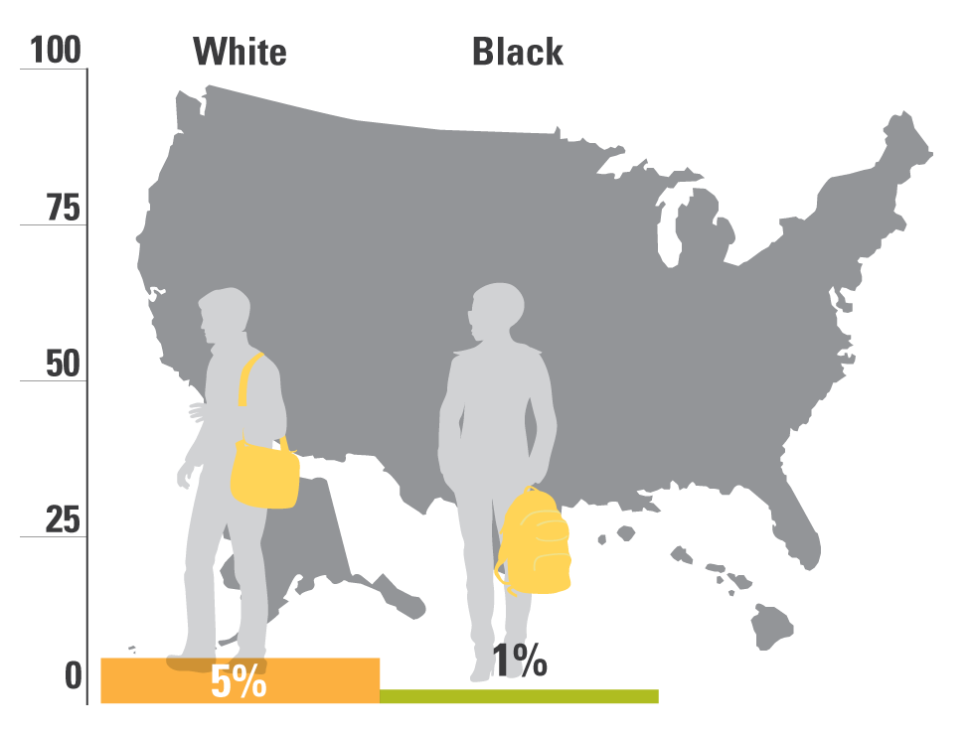
Percent of U.S. adults with a B.A. or more, by race
1960
1980
2000
2012
1920
1940

Slide 13
Then, beginning in the eighties, growing economic inequality started eating away at our progress.

Slide 14
In recent years, most income gains have gone to those at the top of the ladder, while those at the bottom have fallen backwards.
Source: Stiglitz, “Inequality is a Choice,” New York Times, October 13, 2013.

Slide 15
Instead of being the most equal, the U.S. has the third highest income inequality among OECD nations.
United States
Note: Gini coefficient ranges from 0 to 1, where 0 indicates total income equality and 1 indicates total income inequality.
Source: United Nations, U.N. data, http://data.un.org/DocumentData.aspx?q=gini&id=271: 2011

Slide 16
Not just wages and wealth, but social mobility as well.

Slide 17
U.S. intergenerational mobility was improving until 1980, but barriers have gotten higher since.
Source: Daniel Aaronson and Bhashkar Mazumder. Intergenerational Economic Mobility in the U.S.,1940 to 2000. Federal Reserve Bank of Chicago WP 2005-12: Dec. 2005.
Notes:
From the Aaronson and Mazumder report: “In particular, mobility increased from 1940 to 1980, but fell sharply during the 1980s and failed to revert, perhaps even continued to decline, in the 1990s.”
From the Aaronson and Mazumder report, the figure for 2000 (0.58) is not statistically significant. The figure for 1990 (0.46) almost mirrors the number cited for the US in the cross-country analysis on the next slide.

Slide 18
The US now has one of lowest rates of intergenerational mobility
Source: Corak, Miles. Chasing the Same Dream, Climbing Different Ladders. Economic Mobility Project; Pew Charitable Trusts, 2010.
Notes:
Checked 1/8/14 JY
Updated 11/14/13 MW

Slide 19
At macro level, better and more equal education is not the only answer.
But at the individual level, it really is.

Slide 20
There is one road up, and that road runs through us.

Slide 21
So, how are we doing?

Slide 22
First, some good news.
After more than a decade of fairly flat achievement and stagnant or growing gaps in K-12, we appear to be turning the corner with our elementary students.

Slide 23
Since 1999, large gains for all groups of students, especially students of color
*Denotes previous assessment format
National Center for Education Statistics, “The Nation's Report Card: Trends in Academic Progress 2012”

Slide 24
Since 1999, performance rising for all groups of students
*Denotes previous assessment format
National Center for Education Statistics, “The Nation's Report Card: Trends in Academic Progress 2012”

Slide 25
Middle grades are up, too.

Slide 26
Record performance for students of color
*Denotes previous assessment format
National Center for Education Statistics, “The Nation's Report Card: Trends in Academic Progress 2012”

Slide 27
Over the last decade, all groups have steadily improved and gaps have narrowed
*Accommodations not permitted
NAEP Data Explorer, NCES (Proficient Scale Score = 299)

Slide 28
Bottom Line:
When we really focus on something, we make progress!

Slide 29
Clearly, much more remains to be done in elementary and middle school
Too many youngsters still enter high school way behind.

Slide 30
But at least we have some traction on elementary and middle school problems.
The same is NOT true
of our high schools.

Slide 31
Achievement is flat in reading for students overall.
NAEP Long-Term Trends, NCES (2004)

Slide 32
Math achievement for students overall is flat over time.
* Denotes previous assessment format
National Center for Education Statistics, NAEP 2008 Trends in Academic Progress

Slide 33
And despite earlier improvements, gaps between groups haven’t narrowed much since the late 80s and early 90s.

Slide 34
Reading: Not much gap narrowing since 1988.
*Denotes previous assessment format
National Center for Education Statistics, “The Nation's Report Card: Trends in Academic Progress 2012”

Slide 35
Math: Not much gap closing since 1990.
*Denotes previous assessment format
National Center for Education Statistics, “The Nation's Report Card: Trends in Academic Progress 2012”

Slide 36
Moreover, no matter how you cut the data, our students aren’t doing well compared with their peers in other countries.

Slide 37
Of 34 OECD Countries, U.S.A. Ranks 17th in Reading
U.S.A.
Higher than U.S. average Not measurably different from U.S. average Lower than U.S. average
National Center for Education Statistics, 2013, http://nces.ed.gov/surveys/pisa/pisa2012/pisa2012highlights_5a.asp.

Slide 38
Of 34 OECD Countries, U.S.A. Ranks 20th in Science
U.S.A.
Higher than U.S. average Not measurably different from U.S. average Lower than U.S. average
National Center for Education Statistics, 2013, http://nces.ed.gov/surveys/pisa/pisa2012/pisa2012highlights_4a.asp.

Slide 39
Of 34 OECD Countries, U.S.A. Ranks 27th in Math Literacy
OECD
U.S.A.
Higher than U.S. average Not measurably different from U.S. average Lower than U.S. average
National Center for Education Statistics, 2013, http://nces.ed.gov/surveys/pisa/pisa2012/pisa2012highlights_3a.asp.

Slide 40
Only place we rank high?
Inequality.

Slide 41
Among OECD Countries, U.S.A. has the 4th Largest Gap Between High-SES and Low-SES Students
U.S.A.
PISA 2006 Results, OECD, table 4.8b

Slide 42
Among OECD Countries, U.S.A. has the 5th Largest Gap Between High-SES and Low-SES Students
U.S.A.
OECD
PISA 2009 Results, OECD, Table II.3.1

Slide 43
Gaps in achievement begin before children arrive at the schoolhouse door.
But, rather than organizing our educational system to ameliorate this problem, we organize it to exacerbate the problem.

Slide 44
How?
By giving students who arrive with less, less in school, too.

Slide 45
Some of these “lesses” are a result of choices that policymakers make.

Slide 46
National Inequities in State and Local Revenue Per Student
 | Gap
High Poverty vs. Low Poverty Districts | –$1200 per student
High Minority vs. Low Minority Districts | –$2,000 per student
Education Trust analyses based on U.S. Dept of Education and U.S. Census Bureau data for 2010-12

Slide 47
State-by-State Funding Equity: Texas 4th from Bottom (spending not adjusted for extra cost of educating poor children)
The Funding Gap, 2015 The Education Trust

Slide 48
State-by-State Funding Equity: Texas 3rd from Bottom (spending adjusted for extra cost of educating poor children)
Funding Gap 2015, The Education Trust

Slide 49
State-by-State Funding Equity By Concentration of Students of Color: TX 4th From Bottom
Funding Gap, 2015 The Education Trust

Slide 50
In truth, though, some of the most devastating “lesses” are a function of choices that we educators make.

Slide 51
Choices we make about what to expect of whom.....

Slide 52
Students in poor schools receive As for work that would earn Cs in affluent schools.
Source: Prospects (ABT Associates, 1993), in “Prospects: Final Report on Student Outcomes”, PES, DOE, 1997.

Slide 53
Choices we make about what to teach whom…

Slide 54
Even African-American students with high math performance in fifth grade are unlikely to be placed in algebra in eighth grade
Source: NCES, “Eighth-Grade Algebra: Findings from the Eighth-Grade Round of the Early Childhood Longitudinal Study, Kindergarten Class of 1998-99 (ECLS-K)” (2010).

Slide 55
And choices we make about who teaches whom…

Slide 56
Students at high-minority schools more likely to be taught by novice* teachers.
Note: High minority school: 75% or more of the students are Black, Hispanic, American Indian or Alaskan Native, Asian or Pacific Islander. Low-minority school: 10% or fewer of the students are non-White students. Novice teachers are those with three years or fewer experience.
Source: Analysis of 2003-2004 Schools and Staffing Survey data by Richard Ingersoll, University of Pennsylvania 2007.
Notes:
Data is from the 2003-2004 Schools & Staffing Survey (SASS)
SASS surveys a nationally representative sample of teachers.
Analysis examines out-of-field teaching in core academic classes at secondary & middle school:
Core academic classes are English, math, social studies and science.
“Out-of-field” is defined as a teacher lacking both an in-field regular certification and a major in the subject of the classes she/he was assigned to teach
Secondary classes include departmentalized classes in grades 7-12.
Middle grades include 5-8. Only teachers assigned to departmentalized classes count towards middle grades.

Slide 57
Math classes at high-poverty, high-minority secondary schools are more likely to be taught by out-of-field* teachers.
Note: High-poverty school: 55 percent or more of the students are eligible for free/reduced-price lunch. Low-poverty school :15 percent or fewer of the students are eligible for free/reduced-price lunch. High-minority school: 78 percent or more of the students are black, Hispanic, American Indian or Alaskan Native, Asian or Pacific Islander. Low-minority school : 12 percent or fewer of the students are non-white students.
*Teachers with neither certification nor major. Data for secondary-level core academic classes (math, science, social studies, English) across the U.S.
Source: Education Trust Analysis of 2007-08 Schools and Staffing Survey data.
Notes:
Data is from the 2003-2004 Schools & Staffing Survey (SASS)
SASS surveys a nationally representative sample of teachers.
Analysis examines out-of-field teaching in core academic classes at secondary & middle school:
Core academic classes are English, math, social studies and science.
“Out-of-field” is defined as a teacher lacking both an in-field regular certification and a major in the subject of the classes she/he was assigned to teach
Secondary classes include departmentalized classes in grades 7-12.
Middle grades include 5-8. Only teachers assigned to departmentalized classes count towards middle grades.

Slide 58
Los Angeles: Black, Latino students have fewer highly effective teachers, more weak ones.
READING/LANGUAGE ARTS
Latino and black students are:
3X as likely to get low- effectiveness teachers
½ as likely to get highly effective teachers
Source: Education Trust—West, Learning Denied, 2012.

Slide 59
The results are devastating.
Kids who come in a little behind, leave a lot behind.

Slide 60
And these are the students who remain in school through 12th grade.

Slide 61
Students of color are less likely to graduate from high school on time.
Source: National Center for Education Statistics, “Public School Graduates and Dropouts from the Common Core of Data: School Year 2008-09” (2011).

Slide 62
Add those numbers up and throw in college entry and graduation, and different groups of young Americans obtain degrees and very different rates…

Slide 63
Whites attain bachelor’s degrees at twice the rate of blacks and three times the rate of Hispanics.
Source: NCES, Condition of Education 2010 and U.S. Census Bureau, Educational Attainment in the United States: 2011.

Slide 64
Young people from high-income families earn bachelor’s degrees at seven times the rate of those from low-income families.
Source: Postsecondary Education Opportunity, “Bachelor’s Degree Attainment by Age 24 by Family Income Quartiles, 1970 to 2010.”

Slide 65
These numbers are not good news for our country—or for the lives of the young people in question.

Slide 66
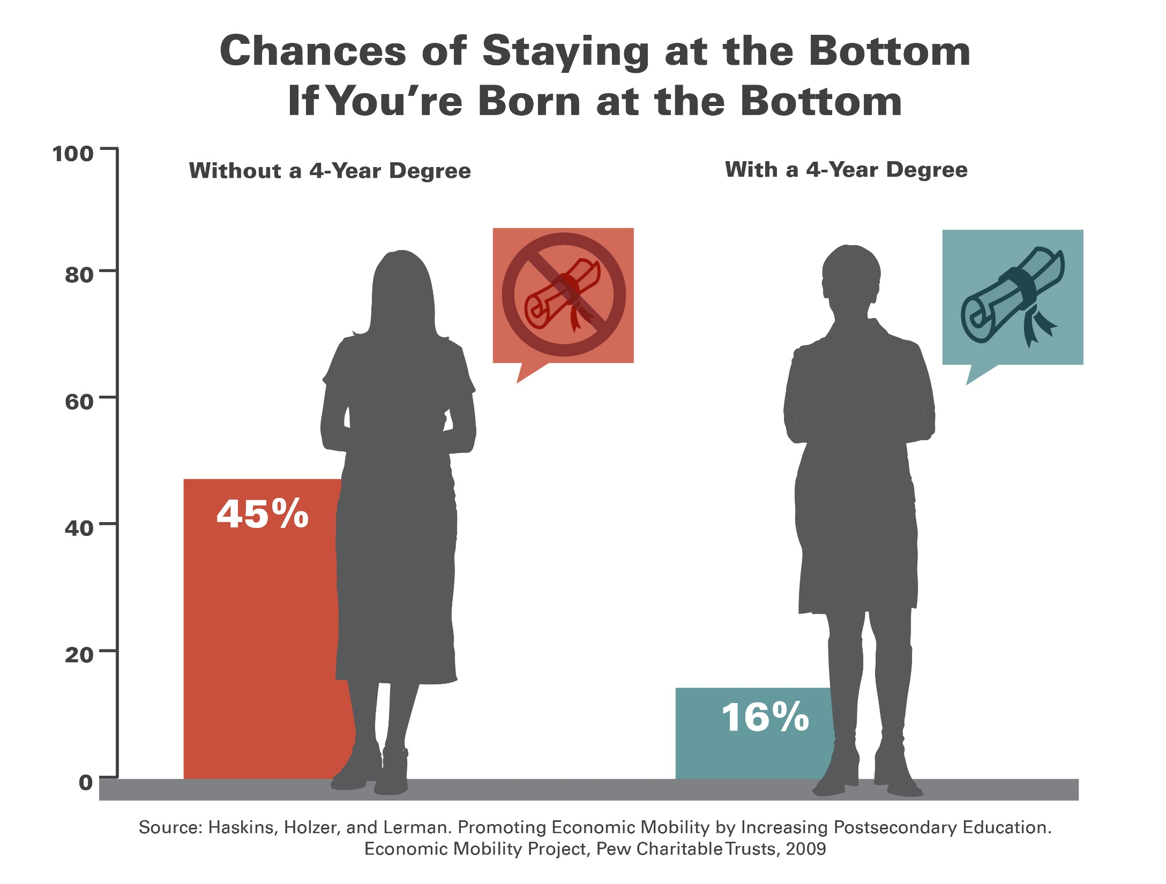
Agenda #1 Working together to get more low-income students and students of color through college.

Slide 67
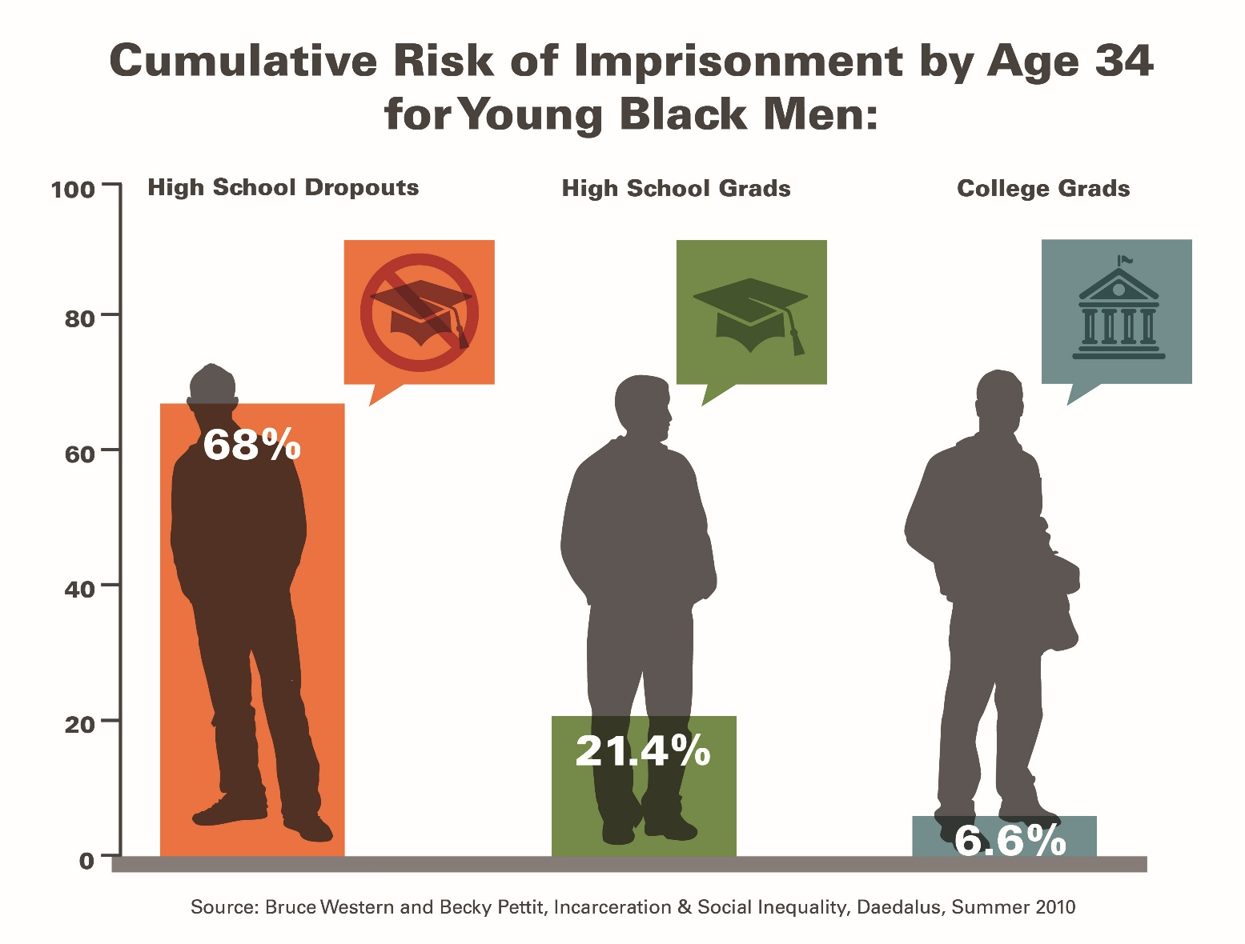
Among black men, education makes a huge difference in life outcomes

Slide 68
What Can We Do?
An awful lot of Americans have decided that we can’t do much.

Slide 69
What We Hear Many Educators Say:
They’re poor
Their parents don’t care
They come to schools without breakfast
Not enough books
Not enough parents
N/A

Slide 70
Let’s be clear, these things do matter.

Slide 71
Child Poverty in the US, 2013
White | 13.4%
Black | 36.9%
Hispanic | 30.4%
Asian | 9.6%
ALL | 19.9%
Source: US Census Bureau

Slide 72
And let’s also be clear: tolerating high child poverty rates is a policy choice. Though we remain the richest nation on earth…

Slide 74
Yet, how we as educators respond to the effects of that choice is a choice, too.

Slide 75
We can choose to go along with what has become conventional wisdom in our profession—that, until we fix poverty, there’s not much we educators can do…

Slide 76
Or we can choose differently.
…joining colleagues in schools all over this country that serve very poor kids but get very good results.

Slide 77
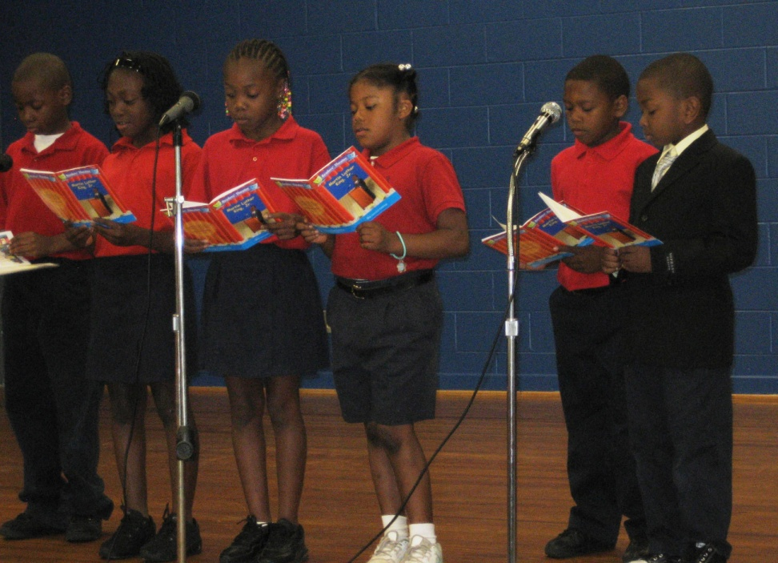
George Hall Elementary School Mobile, Alabama
545 students in grades PK-5
99% African American
98% Low Income
Note: Enrollment data are for 2011-12 school year
Source: Alabama Department of Education
Notes:
Updated

Slide 78
Big Improvement at George Hall Elementary
Alabama Department of Education

Slide 79
Exceeding Standards: George Hall students outperform white students in Alabama
Alabama Department of Education
Notes:
Updated

Slide 80
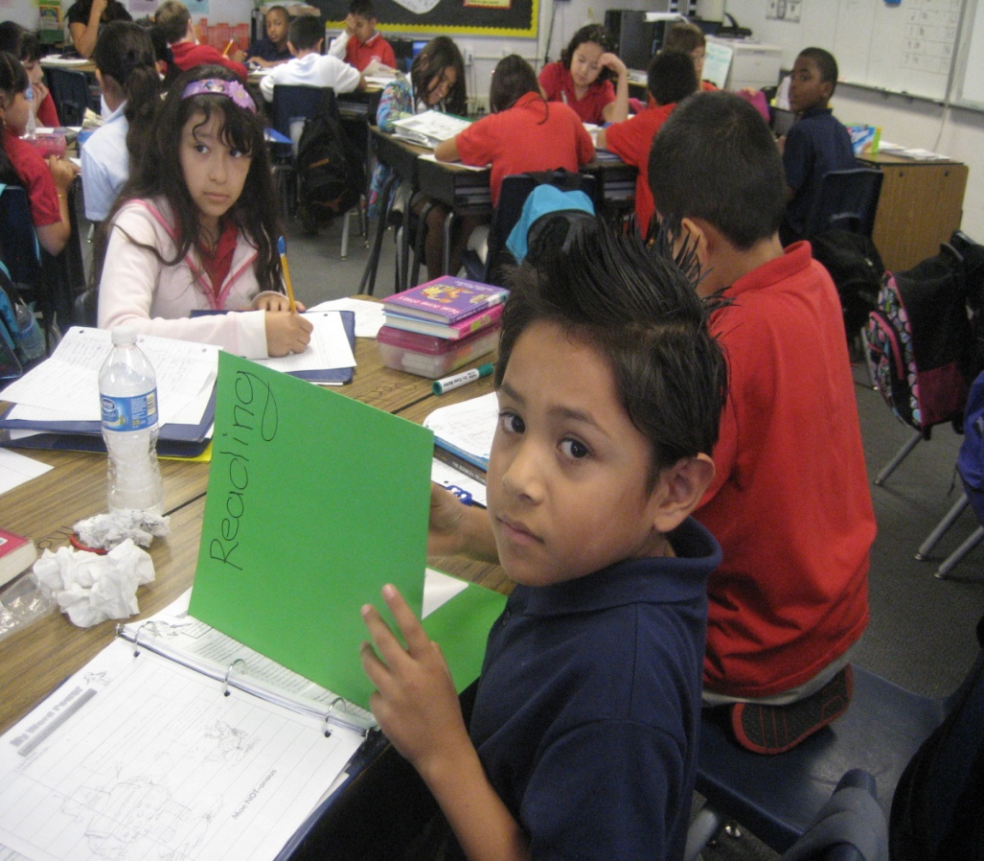
Halle Hewetson Elementary School Las Vegas, NV
962 students in grades PK – 5
85% Latino
7% African American
100% Low Income
71% Limited English
Proficient
Note: Data are for 2010-2011 school year
Source: Nevada Department of Education

Slide 81
Big Improvement at Halle Hewetson Elementary
Source: Nevada Department of Education

Slide 82
High Performance Across Groups at Halle Hewetson Elementary
Source: Nevada Department of Education

Slide 83
Exceeding Standards at Halle Hewetson Elementary
Source: Nevada Department of Education

Slide 84
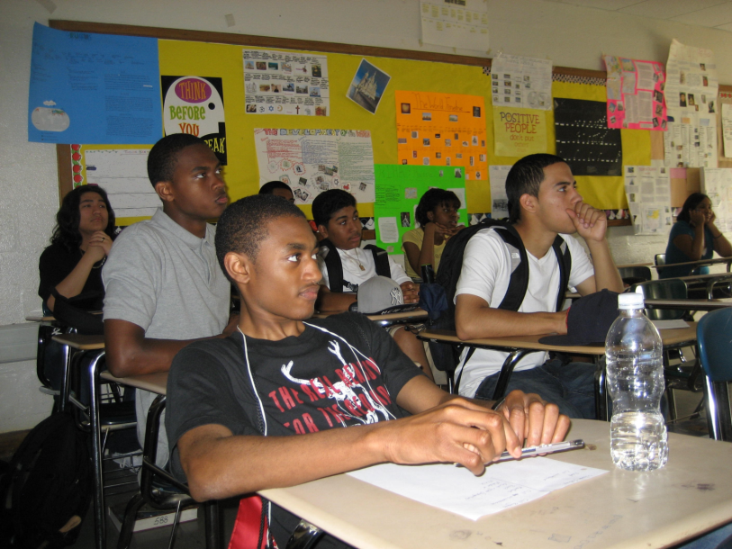
Elmont Memorial High School Elmont, New York
2011-2012 School Year
1,907 students in grades 7-12
78% African American
12% Latino
New York Department of Education

Slide 85
High Performance by ALL Students at Elmont Memorial High School
New York Department of Education https://reportcards.nysed.gov/schools.php?district=800000049235&year=2012

Slide 86
High Performance by ALL Students at Elmont Memorial High School
New York Department of Education https://reportcards.nysed.gov/schools.php?district=800000049235&year=2012

Slide 87
High Graduation Rates at Elmont Memorial High School
Note: Includes students graduating by June 2011.
New York State Department of Education
Notes:
Shows the percentage of students graduating on time with a Regents diploma, a local diploma, or a Regents diploma with advanced designation. This is the 4-year cohort grad rate (started: fall of 2007)
Local diploma: passed 5 Regents exams with a score of 55 or above
Regents diploma: passed 5 Regents with a score of 65 or above
Regents exam with advanced designation: earned 22 units of course credit; passed 7-9 Regents exams at a score of 65 or above; and took advanced course sequences in CTE, the arts, or a language other than English.

Slide 88
This is what happens when teams of educators choose differently.

Slide 89
Available from Harvard Education Press and amazon.com

Slide 90
Just flukes, outliers?
No. Very big differences at district level, too—even in the progress and performance of the “same” group of students.

Slide 91
Average Scale Scores, by District Low-Income African American Students
Note: Basic Scale Score = 208; Proficient Scale Score = 238
NAEP Data Explorer, NCES

Slide 92
Average Scale Scores, by District Low-Income Latino Students
Note: Basic Scale Score = 214; Proficient Scale Score = 249
NAEP Data Explorer, NCES

Slide 93
Average Scale Scores, by District Low-Income African American Students
Note: Basic Scale Score = 214; Proficient Scale Score = 249
NAEP Data Explorer, NCES

Slide 94
Average Scale Scores, by District Low-Income Latino Students
Note: Basic Scale Score = 262; Proficient Scale Score = 299
NAEP Data Explorer, NCES

Slide 95
Even at the state level, there are very big differences in achievement—even of the same group of children.
Some high achieving and high improving, some low achieving and low improving, with others in between.

Slide 96
Performance and Improvement, Low-Income Students: Grade 4 Math

Slide 97
Performance and Improvement: Grade 8 Math

Slide 98
Performance and Improvement: Grade 4 Reading

Slide 99
Performance and Improvement: Grade 8 Reading

Slide 100
Bottom Line: What We Do Matters!

Slide 101
What Can We Learn From Top Performers and Top Gainers?
Five common sense, but ultimately disruptive ideas.

Slide 102
#1. Good schools, districts don’t leave anything about teaching and learning to chance.

Slide 103
An awful lot of our teachers—even brand new ones—are left to figure out on their own what to teach and what constitutes “good enough” work.

Slide 104
What does this do? Leaves teachers entirely on their own to figure out what to teach, what order to teach it in, HOW to teach it…and to what level.

Slide 105
‘A’ Work in Poor Schools Would Earn ‘Cs’ in Affluent Schools
Source: Prospects (ABT Associates, 1993), in “Prospects: Final Report on Student Outcomes”, PES, DOE, 1997.

Slide 106
Students can do
no better than
the assignments
they are given...

Slide 107
Grade 10 Writing Assignment
A frequent theme in literature is the conflict between the individual and society. From literature you have read, select a character who struggled with society. In a well-developed essay, identify the character and explain why this character’s conflict with society is important.

Slide 108
Grade 10 Writing Assignment
Write a composition of at least 4 paragraphs on Martin Luther King’s most important contribution to this society. Illustrate your work with a neat cover page. Neatness counts.

Slide 109
Grade 7 Writing Assignment
Essay on Anne Frank
Your essay will consist of an opening paragraph which introduced the title, author and general background of the novel.
Your thesis will state specifically what Anne's overall personality is, and what general psychological and intellectual changes she exhibits over the course of the book
You might organize your essay by grouping psychological and intellectual changes OR you might choose 3 or 4 characteristics (like friendliness, patience, optimism, self doubt) and show how she changes in this area.
Source: Unnamed school district in California, 2002-03 school year.

Slide 110
Grade 7 Writing Assignment
My Best Friend:
A chore I hate:
A car I want:
My heartthrob:
Source: Unnamed school district in California, 2002-03 school year.
Notes:
This school, not far away, 97% free and reduced price lunch, 99% latino.
FILL IN THE BLANK. OTHERS: A NEAT EXPRESSION __________
Colleagues at ET: Students can do no better than the assignments given.

Slide 111
That was pre- “College-and-Career Ready Standards?”
Do new standards change that?
A brand new EdTrust study

Slide 112
A Deeper Look at What We Did
Analyzed and scored close to 1,600 assignments using our Literacy Assignment Analysis Framework.
Alignment With the Common Core
Centrality of Text
Additional Features Analyzed
Text Type and Length
Writing Output
Length of Assignment
Student Thinking
Domains of Rigorous Student Assignments
Cognitive Challenge
Motivation and Engagement

Slide 113
GRADE 7– English Language Arts
How can we make out voices heard? After reading I am Malala, write a literary essay in which you answer this question. Select and analyze one of the following:
Any key person from the text
The setting
A theme from the text
Support your argument with evidence from the text. In your piece, be sure to write at least 5 paragraphs and follow the structure of a literary analysis.
Notes:
Key Talking Points:
Assignment fell within the HIGH RANGE on the literacy framework (met 6-8 indicators).
This culminating writing assignment comes at the end of a four week unit during which students read and discussed the text I am Malala through the lens of making one’s voice heard.
Strengths:
The task aligns with the Common Core standards; students are expected to build and support a thesis by analyzing textual evidence. Additionally, they are prompted to acknowledge a counterclaim – a distinguishing expectation in the standards for seventh grade writers.
The directions are clear; students know what is expected from them.
The text is central is this assignment; select and analyze textual evidence to support their argument.
High cognitive push for students; they must plan and develop their essay by deciding what their thesis will be, how they will defend or justify it and how they will sequence their ideas across multiple, cohesive paragraphs.
The overarching question of how one makes their voice heard in the world today may resonate for seventh grade students. This question, coupled with a contemporary nonfiction text focused on girl of similar age faced with challenges and injustices may engage students; there is strong potential for students to see the relevancy in these topics and ideas.
Points to Consider:
Text and Task Complexity: The Lexile of the text is 830; which falls into the Grades 4-5 range. While it is a straightforward literary nonfiction text, the setting and culture described in it may be unfamiliar for many students who have grown up in the United States. Additionally, the task students are asked to do with this text is complex and aligns with grade level standards. Question to Consider: Is it appropriate to use a text with a lower Lexile score if the assignments demands cognitive challenge for students that is aligned with grade level standards?
Scaffolds: Within the assignment there are specific expectations laid out by the teacher. They are told to write at least five paragraphs and to follow the structure for a literary analysis (we can infer that this structure was taught to students prior to this assignment). Additionally, students are cued to include an introduction, reasons, analysis, and a conclusion. They are also prompted to use the text and any notes or graphic organizers they have completed over the past four weeks. Two self-checklists are also provided as part of the assignment. Question to Consider: Are the embedded scaffolds a help or a hindrance for seventh grade students?
Motivation and Engagement: There is limited choice in this assignment. Although all students are expected to base their essay on the text I am Malala, students are allowed to choose how they will frame their analysis (e.g. any key person, the setting, a theme). As mentioned above, there is potential relevancy in the question of making one’s voice heard – and the ideas in this text are indeed contemporary and are expressed through the words of a young person. Questions to Consider: Are there other ways that choice and relevancy could be incorporated into this assignment?

Slide 114
GRADE 7 - English Language Arts
Read the poem, then fill in the blanks to create your own poem to communicate your thoughts and feelings about unfinished business in your life.
The Song I couldn’t Finish
by Jeanne
The words I couldn’t say
The call I couldn’t make
The time I couldn’t spend with you
The walls I couldn’t break through
The breath I couldn’t take
The air I couldn’t release
The love I couldn’t feel
The person I couldn’t convince
The song I couldn’t finish
Notes:
Key Talking Points:
Assignment fell within the LOW RANGE on the literacy framework (met 0-2 indicators).
Students are assigned to read a simple poem and then are tasked to create their own poem which mirrors it
Scaffolding is present throughout this assignment
The “fill in the blank” cloze activity leaves little room for choice and fostering student autonomy; although students are able to make changes to the proscribed outline
While the topics and ideas of the poem may resonate for young adolescents, they represent standalone points – rather than linked to ELA content or complex texts
Strengths/Weaknesses:
Assignment is clear, but does not align with Grade 7 Common Core ELA standards for reading or writing
The text is simple; students are not required to cite evidence or justify their thinking
Poetry writing is presented in a lockstep, proscribed manner
Few opportunities for creation/choice; relevance is linked with low-level; simple materials and task
Questions to Consider:
How might students engage in poetry writing that both honors their unique perspectives and pushes for complex thinking?
How can assignments couple relevance and engagement with rigorous content, texts, and tasks?

Slide 115
GRADE 7 - English Language Arts (continued)
The words I couldn’t say
I couldn’t say ___________________________
The things I couldn’t change
I couldn’t ______________________________
The walls I couldn’t break through
I couldn’t find a way to __________________
The feelings I couldn’t feel
I couldn’t ______________________________
The help I couldn’t give
I couldn’t ______________________________
The song I couldn’t finish
The song was about ____________________

Slide 116
In isolation, the low assignments can reflect targeted skill building and student practice…not necessarily harmful in moderation

Slide 117
However when compounded over multiple class periods, in multiple subjects, over multiple years, the effect is detrimental.

Slide 118
Ed Trust Assignment Study: What We Found
Fewer than 4 in 10 middle grades assignments are targeted at a grade-appropriate standard;
In high poverty schools the proportion drops to only about one third, compared to nearly half of assignments in low poverty schools;
That said, only about 5% of assignments in both kinds of schools tapped into the higher-level cognitive demands of the CCSS;
Most efforts at engagement and relevance were superficial, and often condescending.
Notes:
Text from current PPT presentation

Slide 119
And don’t think that your students don’t know the difference….

Slide 122
High Performing Schools and Districts Know That Standards Alone Aren’t Enough
Have clear and specific goals for what students should learn in every grade, including the order in which they should learn it;
Provide teachers with common curriculum, assignments;
Have regular vehicle to assure common marking standards;
Assess students regularly to measure progress; and,
Don’t leave student supports to chance.

Slide 123
In other words, they strive for consistency in everything they do.

Slide 124
#2. Good schools, districts know how much teachers matter, and they act on that knowledge.
Not leaving anything to chance means not leaving who teaches whom to chance, either.

Slide 125
In our roles as parents…

Slide 126
Students in Dallas Gain More in Math with Effective Teachers: One Year Growth From 3rd-4th Grade
Source: Heather Jordan, Robert Mendro, and Dash Weerasinghe, The Effects of Teachers on Longitudinal Student Achievement, 1997.

Slide 127
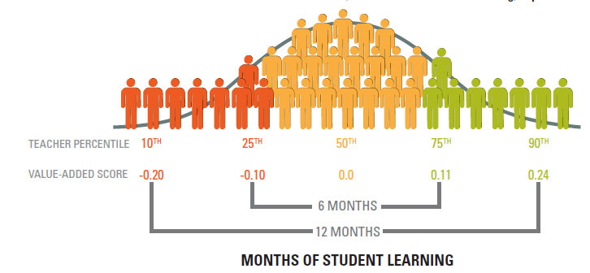
DIFFERENCES IN TEACHER EFFECTIVENESS ACCOUNT FOR LARGE DIFFERENCES IN STUDENT LEARNING
The distribution of value-added
scores for ELA teachers in LAUSD

Slide 128
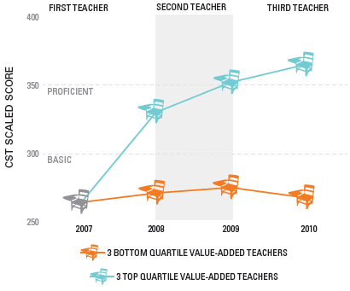
ACCESS TO MULTIPLE EFFECTIVE TEACHERS CAN DRAMATICALLY AFFECT STUDENT LEARNING
CST math proficiency trends for second-graders at ‘Below Basic’ or ‘Far Below Basic’ in 2007 who subsequently had three consecutive high or low value-added teachers

Slide 129
And, no matter how you measure, some kids aren’t getting their fair share.

Slide 130
Students at High-Minority Schools More Likely to Be Taught By Novice* Teachers
Note: High minority school-75% or more of the students are Black, Hispanic, American Indian or Alaskan Native, Asian or Pacific Islander. Low-minority school -10% or fewer of the students are non-White students.
*Novice teachers are those with three years or fewer experience.
Source: Analysis of 2003-2004 Schools and Staffing Survey data by Richard Ingersoll, University of Pennsylvania 2007.
Notes:
Data is from the 2003-2004 Schools & Staffing Survey (SASS)
SASS surveys a nationally representative sample of teachers.
Analysis examines out-of-field teaching in core academic classes at secondary & middle school:
Core academic classes are English, math, social studies and science.
“Out-of-field” is defined as a teacher lacking both an in-field regular certification and a major in the subject of the classes she/he was assigned to teach
Secondary classes include departmentalized classes in grades 7-12.
Middle grades include 5-8. Only teachers assigned to departmentalized classes count towards middle grades.

Slide 131
Math Classes at High-Poverty and High- Minority Schools More Likely to be Taught by Out of Field* Teachers
Note: High Poverty school-75% or more of the students are eligible for free/reduced price lunch. Low-poverty school -15% or fewer of the students are eligible for free/reduced price lunch. High minority school-75% or more of the students are Black, Hispanic, American Indian or Alaskan Native, Asian or Pacific Islander. Low-minority school -10% or fewer of the students are non-White students.
*Teachers with neither certification nor major. Data for secondary-level core academic classes (Math, Science, Social Studies, English) across USA.
Source: Analysis of 2003-2004 Schools and Staffing Survey data by Richard Ingersoll, University of Pennsylvania 2007.
Notes:
Data is from the 2003-2004 Schools & Staffing Survey (SASS)
SASS surveys a nationally representative sample of teachers.
Analysis examines out-of-field teaching in core academic classes at secondary & middle school:
Core academic classes are English, math, social studies and science.
“Out-of-field” is defined as a teacher lacking both an in-field regular certification and a major in the subject of the classes she/he was assigned to teach
Secondary classes include departmentalized classes in grades 7-12.
Middle grades include 5-8. Only teachers assigned to departmentalized classes count towards middle grades.

Slide 132
Tennessee: High poverty/high minority schools have fewer of the “most effective” teachers and more “least effective” teachers
Note: High Poverty/High minority means at least 75% qualify for FRPL and at least 75% are minority.
Source: Tennessee Department of Education 2007. “Tennessee’s Most Effective Teachers: Are they assigned to the schools that need them most?” http://tennessee.gov/education/nclb/doc/TeacherEffectiveness2007_03.pdf

Slide 133
Los Angeles: LOW-INCOME STUDENTS LESS LIKELY TO HAVE HIGH VALUE-ADDED TEACHERS
ELA
MATH
In math, a student from a relatively more affluent background is 39% more likely to get a high value-added math teacher.
A low-income student is more than twice as likely to have a low value-added teacher for ELA
 | A low-income student is 66% more likely to have a low value-added teacher.
 | A student from a relatively more affluent background is 62% more likely to get a high value-added ELA teacher.
Notes:
Animated slide.

Slide 134
Remember: These same inequities often occur even within the same school, where the most experienced and best educated teachers teach the “top” kids and the seniors, while the novices are assigned to “remedial” kids and freshmen.

Slide 135
Low-Achieving Students are More Likely to be Assigned to Ineffective Teachers than Effective Teachers
Source: Sitha Babu and Robert Mendro, Teacher Accountability: HLM-Based Teacher Effectiveness Indices in the Investigation of Teacher Effects on Student Achievement in a State Assessment Program, AERA Annual Meeting, 2003.
Notes:
Another set of researchers in Dallas TX found that students with a previous history of low-achievement were more likely to be assigned to ineffective tchrs. Over all three grades we see more low achievers being assigned to ineffective tchrs and in 6th grade the difference is remarkable with 125 more students assigned to ineffective tchrs.

Slide 136
These patterns not, however, inevitable.
Charlotte’s Strategic Staffing Initiative

Slide 137
Putting it All Together: Charlotte’s Strategic Staffing Initiative
Experienced, high performing principal;
Gets to bring in 6 high performing teachers from elsewhere in district, and bump out that many low performers;
Two years of autonomy to produce turn around results;
Near 100% results.

Slide 138
#3. Good schools, districts don’t think about closing the achievement gap only as “bringing the bottom up.”

Slide 139
In part because of the push from NCLB, there’s been a lot of energy directed at bringing bottom achievers up.

Slide 140
Percentage Below Basic Over Time
*Accommodations not permitted
National Center for Education Statistics, NAEP Data Explorer, http://nces.ed.gov/nationsreportcard/nde/

Slide 141
Percentage Below Basic Over Time
*Accommodations not permitted
National Center for Education Statistics, NAEP Data Explorer, http://nces.ed.gov/nationsreportcard/nde/

Slide 142
At the same time, though…

Slide 143
Percentage Advanced Over Time
*Accommodations not permitted
National Center for Education Statistics, NAEP Data Explorer, http://nces.ed.gov/nationsreportcard/nde/

Slide 144
Percentage Advanced Over Time
*Accommodations not permitted
National Center for Education Statistics, NAEP Data Explorer, http://nces.ed.gov/nationsreportcard/nde/

Slide 145
Percentage Advanced Over Time
*Accommodations not permitted
National Center for Education Statistics, NAEP Data Explorer, http://nces.ed.gov/nationsreportcard/nde/

Slide 146
We can—and must—do better.

Slide 147
#4. In good schools, educators know that they have enormous power to shape children’s lives.

Slide 148
They know that it’s not about heroic individuals.
That path, as we all know, is unsustainable.

Slide 149
But they have seen the awesome power of the collective—some describe it as the “huddle”—to lift children up.
As well as the destructive power of individual adults to tear children down.

Slide 150
So they organize and celebrate the lifting, and they do not tolerate those who tear down.

Slide 151
No, things aren’t fair out there.
And we should fight hard to make sure families get what they need.

Slide 152
But in the meantime, we have enormous power to pave the path upward for far more children…

Slide 153
And they need us to exercise that power.

Slide 154
5. Accountability systems that set stretch goals for every group of children put leverage behind change-oriented leaders.

Slide 155
Just as low standards undermine good teachers—who know that that level of work is not good enough—weak accountability systems undermine good leaders.

Slide 156
Those of you outside of schools, do the educators inside them—and certainly their students—no favors if you explain away poor performance instead of pressing for more.

Slide 157
You taught the country that in the 1990’s, when your growth—especially for low-income children and children of color—led the nation, especially in math.

Slide 158
Please don’t forget that lesson now.

Slide 159
Download this presentation on our website
www.edtrust.org
Washington, D.C. Metro Detroit, MI
202/293-1217 734/619-8009
Oakland, CA
510/465-6444

